Slide 1




APANA TIME
Lokesh Kumar
Emp. ID: ATAI20250509
Batch: ATAI2505
DataAnalystBot
AI-Powered Assistant for Data Analytics
Retrieval-Augmented Generation with large language models
Mentor:
Mr. Anish Kumar

Slide 2



Problem
Statement
Multiple Data Sources complexity
Fragmented Workflow Issues
Limited Tool Capabilities
Integration Gaps

Slide 3

Project Overview
For Data Analyst Bot
DataAnalystBot is an AI-powered assistant for data analysis, supporting text, image, CSV, and PDF queries. It uses retrieval-augmented generation, session memory, and file caching to deliver context-aware answers. Built with Streamlit and FastAPI, it offers a modern, interactive chat interface for efficient, multimodal data exploration and insights.

Slide 4


Vision
Democratize Data Analysis
Intelligent Conversational Assistant
Universal Data Insight Platform

Slide 5


Key
Features
Multimodal Analysis
Smart Context Management
User Experience
Technical Architecture

Slide 6

Tech
Retrieval-Augmented Generation
Stack
Implements a RAG pipeline using FAISS for fast, semantic search over a chunked knowledge base
Large Language Model (LLM)
DataAnalystBot combines Streamlit for a real-time interactive UI and FastAPI for a fast backend. It uses Groq's Llama models, FAISS, and HuggingFace embeddings for AI and semantic search. Data is managed via in-memory sessions, DiskCache, and Selenium scrapers, enabling fast, context-rich data analysis.
Utilizes Groq Llama 3 & Multimodal Llama 4 for both text and image understanding and also for csv and pdf analyzing.
Session Memory
Maintains per-session chat history in memory, allowing context-aware and continuous conversations.
Backend
Powered by FastAPI providing RESTful endpoints with CORS enabled for seamless frontend-backend integration.

Slide 7
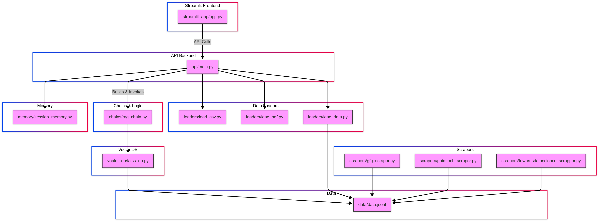
WorkFlow

Slide 8
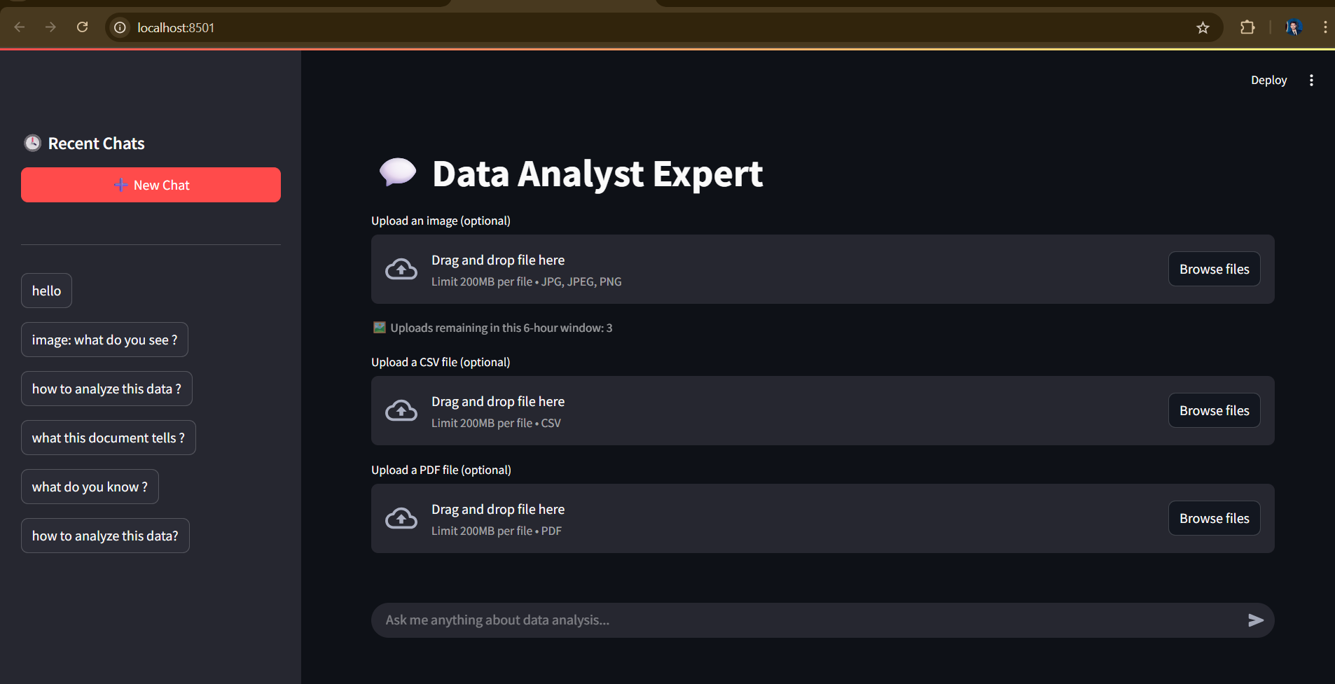
Screenshots

Slide 9
Challenges and
Ethical Considerations
When creating separate endpoints for image and CSV processing, the model started replacing the original FAISS knowledge base with only the new file data. This caused the model to lose access to its complete knowledge base, resulting in limited and less informative responses due to using separate chains for each endpoint type.
Data Privacy and Security
Bias and Fairness
01
02
Safeguarding sensitive information used in AI processes using hashing.
Regular knowledge base reviews and updates
Authenticity and Trust
Regulatory Compliance
03
04
Secure session handling without data persistence
Session-only data storage for privacy protection

Slide 10
References
LangChain Documentation
Groq API & Documentation
HuggingFace Transformers
FAISS: Facebook AI Similarity Search
Streamlit Documentation
FastAPI Documentation
DiskCache Documentation
Selenium Documentation
GeeksforGeeks
TPointTech

Slide 11

Conclusion
DataAnalystBot makes data analysis easy and fast using AI and a simple chat interface. It works with text, images, CSVs, and PDFs, and remembers past conversations to give better answers.
How businesses benefit:
Get insights quickly without needing technical skills.
Save time by asking questions instead of writing code.
Help teams make faster, smarter decisions.
Use one tool for all types of dataIn short, DataAnalystBot helps businesses turn raw data into clear answers — leading to better strategies and faster growth.

Slide 12


Lokesh Kumar
Thank You
Ask your questions!

